Slide 1
Fiber Optics
Dr. Archana Sharma

Slide 2
INTRODUCTION
You hear about fiber-optic cables whenever people talk about the telephonic system, the cable TV system or the Internet.
Fiber-optic lines are strands of optically pure glass as thin as a human hair that carry digital information over long distances.
Optical fibers works as Wave guides in optical television signals, digital data to transmit voice television signals, digital data to any desired distance from one end to the other end of the fiber.
They are also used in medical imaging and mechanical engineering inspection.

Slide 3
STRUCTURE OF AN OPTICAL FIBER
Core: It is an inner cylindrical material made up of glass or plastic. Diameter: 8-100 µm.
Cladding: It is a cylindrical shell of glass or plastic material in which Core is inserted. Diameter: 50-200 µm.
Protective Jacket: The Cladding is enclosed in polyurethane jacket and it protects the fiber from surroundings. Diameter: 100-400 µm.

Slide 4
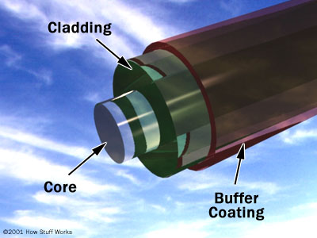
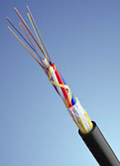
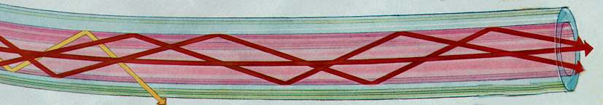
STRUCTURE OF AN OPTICAL FIBER

Slide 5
PRINCIPLE OF LIGHT PROPAGATION
IN FIBER OPTICS
RARER MEDIUM: n₁
NORMAL
NORMAL
r = 90
r
DENSER MEDIUM: n₂

Slide 6
TOTAL INTERNAL REFLECTION
NORMAL
RARER MEDIUM
DENSER MEDIUM

Slide 7
To calculate critical angle

Slide 8
ACCEPTANCE ANGLE
The maximum angle of incidence at the end face of an Optical fiber for which the light ray can be propagated along Core-Cladding interface is known as maximum Acceptance angle.
Core-Cladding interface
n₀ for air media
θ_{r}
θ
Core n₁
θ_{r}
Fiber axis
Cladding n₂
Incident light ray

Slide 9
ACCEPTANCE CONE
Rotating the Acceptance angle about the fiber axis describes the Acceptance Cone of the fiber. Light launched at the fiber end within this Acceptance Cone alone will be accepted and propagated to the other end of the fiber by total internal reflection.
θm
θm
Acceptance Cone

Slide 10
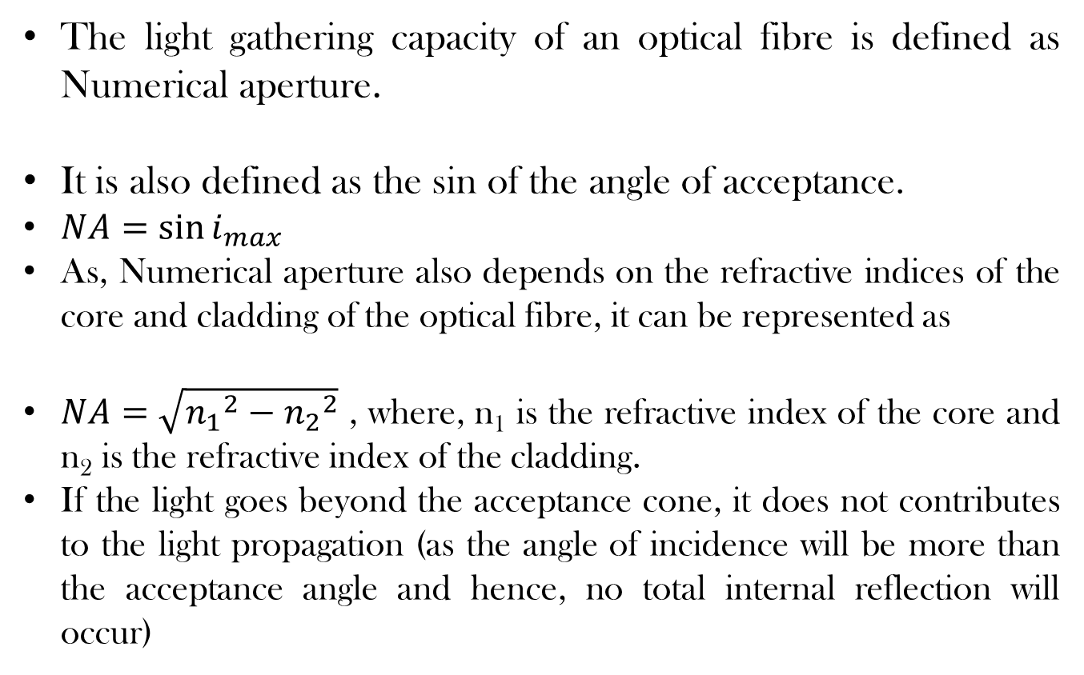
NUMERICAL APERTURE

Slide 11
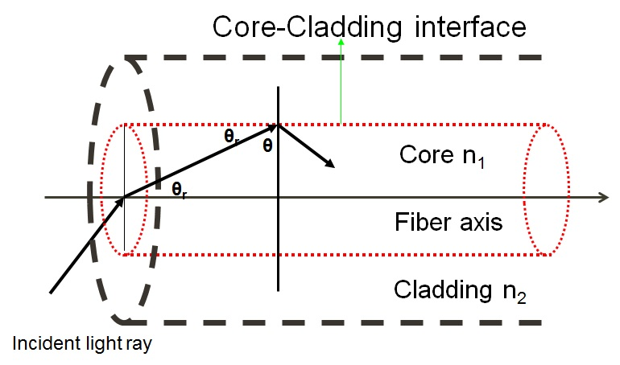
Derivation of the formula for Numerical Aperture
Applying Snell’ s law for Air-Core media

Slide 13
This is the required expression for Maximum Acceptance Angle in optical fibers.

Slide 14
IMPORTANT PARAMETERS
The light gathering capacity of an optical fiber is known as Numerical Aperture and it is proportional to Acceptance Angle.
It is numerically equal to sine of Acceptance Angle.
The ratio between the difference in RI’s of Core and Cladding to that of RI of core is called the Fractional change Δ.
V- number: Normalized frequency of the fiber.
N_{max}: Maximum no. of modes allowed by the optical fiber.

Slide 15
IMPORTANT FORMULAE
NA: Numerical Aperture
θ_{max:} Acceptance angle
n₁: RI of core
n₂: RI of cladding
n₀: RI of the medium
Δ: Fractional change in RI
V: V-number
a: radius of the core
N_{max}: No. of allowed modes

Slide 16
CLASSIFICATION OF OPTICAL FIBER
Based on material used
Silica Fiber
Plastic fiber
Based on Refractive Index
Step Index Fiber
Graded Index Fiber
Modes of Propagation
Single Mode
Multimode
Plastic clad fiber

Slide 17
BASED ON THE REFRACTIVE INDEX OF THE CORE AND CLADDING

Slide 18
STEP INDEX FIBER
The RI is constant for the core in this fiber. As we go radically from center of the core, the RI undergoes a step change at core-cladding interface .
The core diameter of this fiber is about 8 to 10µm and the outer diameter of cladding is 60 to 70µm.
It is a reflective fiber since light is transmitted from one end to the other end of a fiber by TIR.
These are extensively used because distortion and transmission losses are very less.

Slide 19
REFRACTIVE INDEX PROFILE OF STEP INDEX FIBER
60 to 70 µm
8 to 10 µm
RI
Radial distance

Slide 20
GRADED INDEX FIBRE
In this fiber , the RI of Core continuously decreases from center to the surface.
The RI is maximum at the center of Core and minimum at the Surface.
This fiber can be a single mode or Multimode ,the diameters of core and cladding varies from 50-200µm and 100-250µm respectively.
Light propagation takes place in a parabolic path.

Slide 21
REFRACTIVE INDEX PROFILE OF GRADED INDEX FIBER
100 to 250 µm
50 to 200 µm
RI
Radial distance

Slide 22
BASED ON THE MODES OF PROPAGATION

Slide 23
SINGLE MODE STEP INDEX FIBER
CLADDING
CORE
Signal propagates in only one mode.
Core diameter is very small of the order of 8-10 µm
Light travels parallel to the axis of the core.
Transmission loss of the signal is very small.

Slide 24
MULTIMODE STEP INDEX FIBER
CLADDING
CORE
MMSIF permits large no. of signal to propagate through it.
Different modes of rays have different angle of incidence at the core cladding interface.
Different signal arrive at different time.
They are best suited for short distance signal transmission.

Slide 25
MUTI-MODE GRADED INDEX FIBER
CLADDING
CORE
Allows a large number of signals to propagate.
Angle of incidence of the signal in the region of high RI to the region of low RI continuously bends.
The rays propagates in the form of skew rays or helical manner.

Slide 27
BASED ON THE MATERIAL OF THE CORE AND CLADDING

Slide 28
TYPES OF FIBER BASED ON MATERIALS
SILICA FIBER:
Core and cladding made up of fused silica or fused quartz.
Adding Ge or P in fused Silica: RI increases
Adding B or F: RI decreases.
Adding impurities can cause attenuation or scattering of the signal.
PLASTIC FIBER
Core and cladding made of plastic
Light and flexible
Used for short distance applications
PLASTIC CLAD FIBER
Core is made of glass and cladding is made of polymer.
Light, flexible and cheap.
losses are more.
Suitable for short distances.

Slide 30
LOSSES IN OPTICAL FIBRE

Slide 31
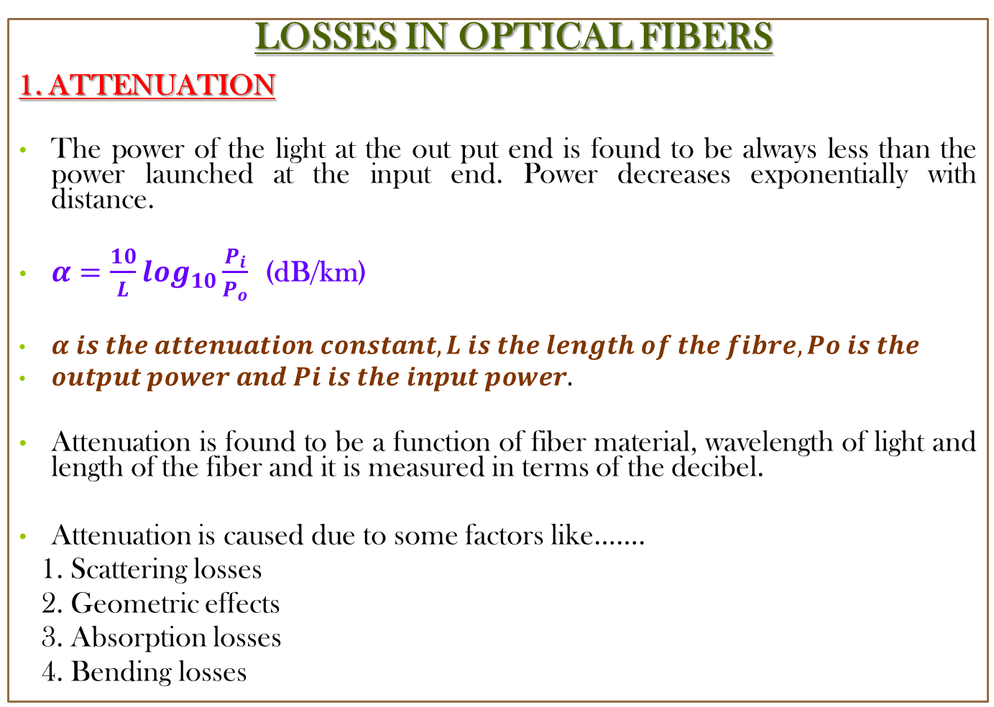
LOSSES IN OPTICAL FIBERS
1. ATTENUATION
The power of the light at the out put end is found to be always less than the power launched at the input end. Power decreases exponentially with distance.
$α=\frac{10}{L}\log_{10}\frac{P_{i}}{P_{o}}$ (dB/km)
$α is the attenuation constant, L is the length of the fibre, Po is the$
$output power and Pi is the input power.$
Attenuation is found to be a function of fiber material, wavelength of light and length of the fiber and it is measured in terms of the decibel.
Attenuation is caused due to some factors like…….
1. Scattering losses
2. Geometric effects
3. Absorption losses
4. Bending losses

Slide 32
ABSORPTION:
Impurities present in the material
Absorbs light of some specific wavelength region.
GEOMETRIC EFFECTS:
Non uniformity of the core cladding interface results in the escape of light
as the condition of TIR is not satisfied.
SCATTERING:
Glass has disordered structure.
Variation in density leads to change in RI
Light scatters and hence suffers loss given by 1/λ⁴
BENDING LOSS:
Bending of Optical Fiber causes strain
RI of the core and critical angle of the cladding gets affected.
Transmitted light suffers reflection and refraction at both at the bending.

Slide 33
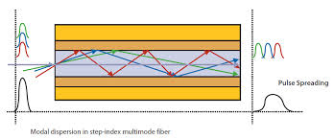
2. DISTORTION/DISPERSION
Broadening of the light pulse while transmitting through the optical fiber.
It is expressed in ns/km.
Types of Distortion
INTERMODAL DISTORTION
Different modes have different velocities. Time for reaching the output end is different thus, leading to the pulse broadening.

Slide 34
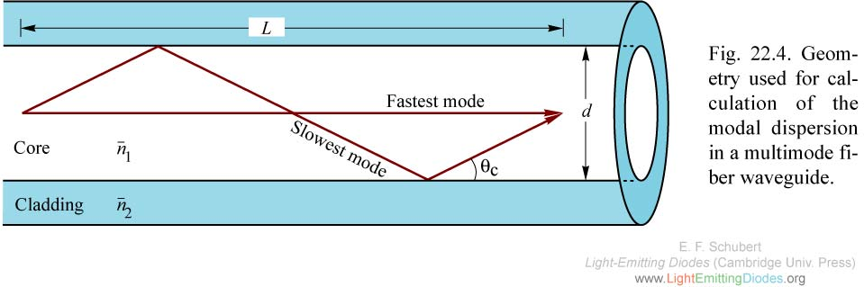
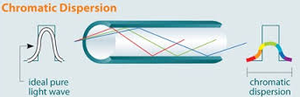
2. INTRAMODAL DISPERSION
Waveguide dispersion:
(b) Material dispersion

Slide 35
APPLICATION OF OPTICAL
FIBRES FOR COMMUNICATION

Slide 36
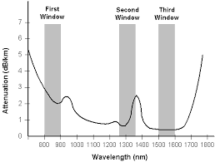
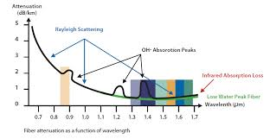
Optical window
For better performance choice of wavelength is must- to minimize loss and dispersion.
The band of wavelengths at which the attenuation is a minimum is called optical window or transmission window or low loss window.
The minimum attenuation is in the range of 1500-1600 nm, hence is most preferable wavelength for transmission.

Slide 37
OPTICAL FIBER COMMUNICATION SYSTEM
An efficient optical fiber communication system requires high information carrying capacity such as voice signals, video signals over long distances with a minimum number of repeaters. It essentially consists of following parts.
1. Encoder
2. Transmitter
3. Wave guide
4. Receiver
5. Decoder

Slide 38
TRANSMITTER
Electrical
signal
OPTICAL SIGNAL
DRIVE SOURCE
LIGHT SOURCE
ENCODER
PHOTO
DETECTOR
SIGNAL
RESTORER
DECODER
Wave guide
AMPLIFIER
Receiver

Slide 39
1. ENCODER: It converts electric signal corresponding to analog information such as voice, figures, objects etc. into a binary data. This binary data comes out in the form of stream of electrical pulses.
2. TRANSMITTER: It mainly consists of driver circuit and a light source. Digital modulation is commonly used in optical fiber communication where the signal is coded using discrete bits. Driver circuit converts the coded electrical signal into optical form. An LED or a Laser diode is used as the converter.
3. RECIEVER: The data in the form of light is connected to a photo detector. A small current is generated when the light is incident on it. The pulse often requires amplification as the value is very small. A wave-shaper circuit may be required to retain the form of original signal.

Slide 40
ADVANTAGES OF OFC
Extremely high data rate → very fast communication
Very less attenuation → good signal strength is maintained
Very less noise → no cross communication and no electromagnetic interference.
Better signal security
Fibers are cheap as raw material silica is available in large extent as compare to Cu,Al,Ag.
Less weight so useful in space craft.
DISADVANTAGES OF OFC
As for making fiber connections sophisticated machineries and very skilled technicians are required so installation of OFC is costly and difficult hence fiber to home is difficult, is the only drawback of an OFC.

Slide 41
OTHER APPLICATIONS OF OPTICAL FIBER
Medical applications such as fiberoscopes used in endoscopic applications
Military applications such as fibre guided missiles.
Useful in sensors technology. All kind of sensors are possible using fibers with various added features and wide range.

Slide 42
BIT RATE
No of binary digits communicated per unit time is called as the bit rate.
It can also be defined as number of pulses propagating per unit time.
More the bit rate→ faster will be the communication.
It is also called as the data rate of the fiber. Commercially it is of the order of Gb/sec.
Pulse dispersion limits BIT rate.
Lower the dispersion higher the bit rate. B_{max}=1/(5dispersion).

Slide 43
Bandwidth and Bandwidth distance product
Maximum frequency that can be propagated through the fiber is defined as bandwidth .
Bandwidth distance product specifies information capacity of the fiber MHz.km=310/[dispersion(ns/km)]
Higher the frequency at which information is transferred lower the distance to which it will be transferred and vice a versa .

Slide 44
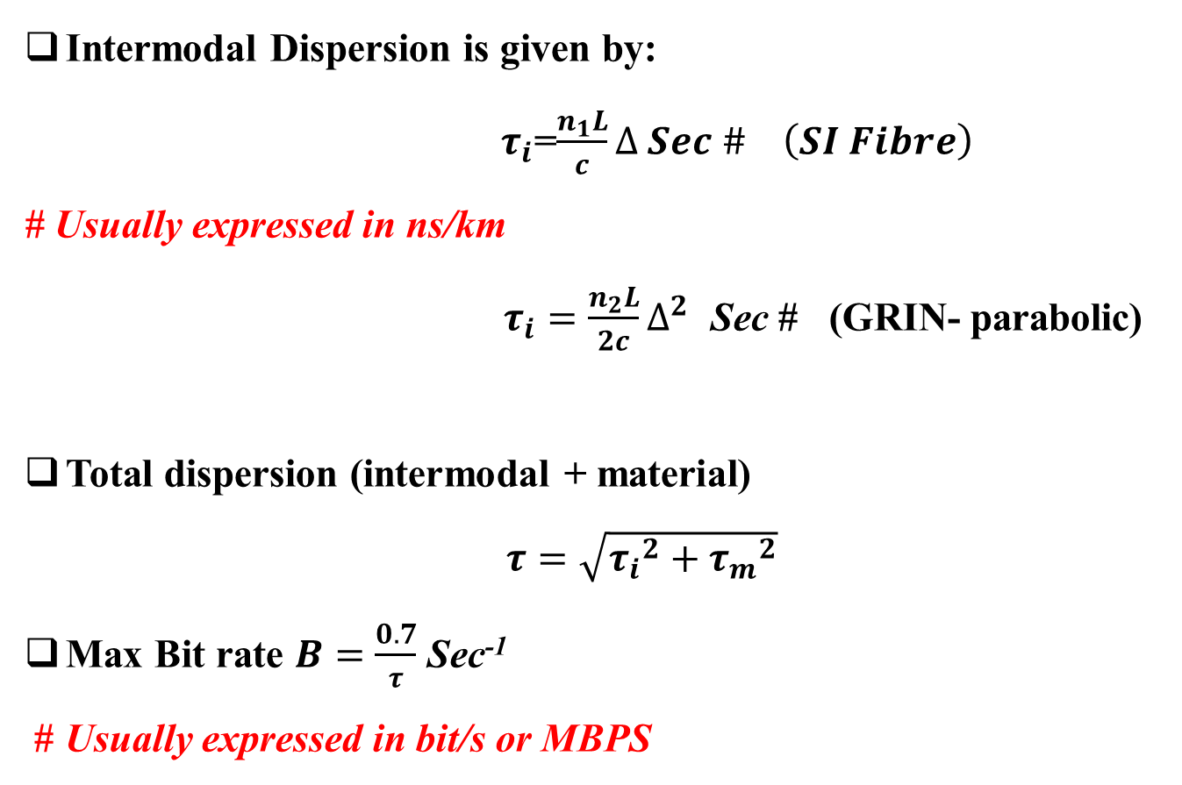
PULSE DISPERSION AND BIT RATE
Intermodal Dispersion is given by:
$τ_{i}$=$\frac{n_{1}L}{c}∆ Sec \# \left(SI Fibre\right)$
# Usually expressed in ns/km
$τ_{i}=\frac{n_{2}L}{2c}∆^{2}$ Sec # (GRIN- parabolic)
Total dispersion (intermodal + material)
$τ=\sqrt{{τ_{i}}^{2}+{τ_{m}}^{2}}$
Max Bit rate $B=\frac{0.7}{τ}$ Sec⁻¹
# Usually expressed in bit/s or MBPS

